Slide 1


Introduction to Software Engineering
Assignment 1

Slide 2
Nagham Wael Mohamed 20231189
Fatema El-Zhraa Ahmed Mohamed El-Fiky 20230280
Aly El-Deen Yasser Ali 20231109

Slide 3
Java Programs

Slide 4
Aly El-Deen Yasser Aly:
Hours of Study: 18 hours
Source of study https://youtube.com/playlist?list=PLCInYL3l2AajYlZGzU_LVrHdoouf8W6ZN&si=tfRlF2iNxOtJehum
Video Link: https://youtu.be/-brwmS8jSZo

Slide 5
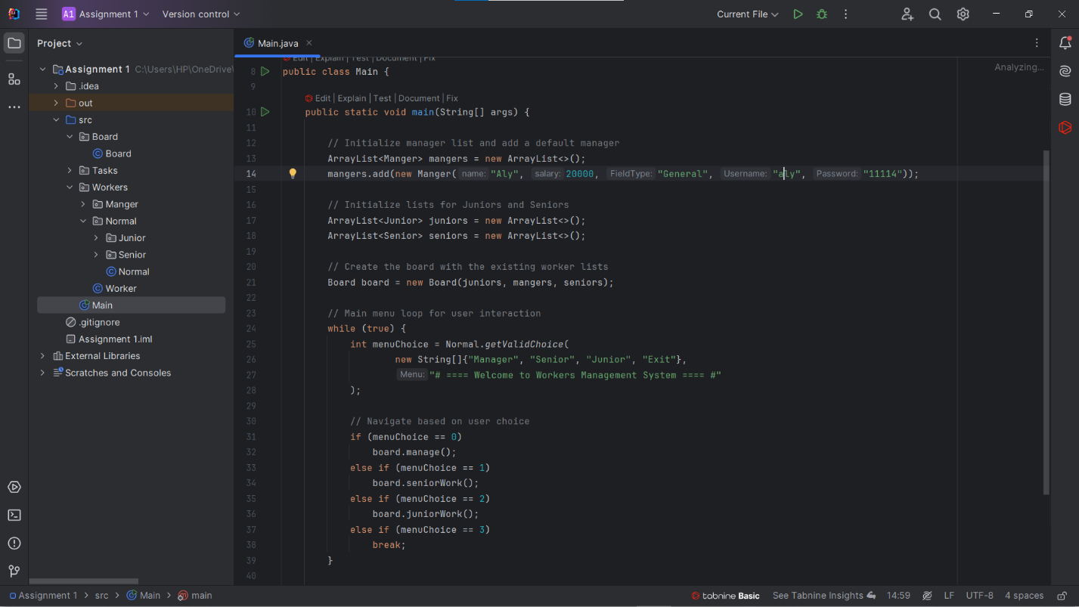

Slide 6
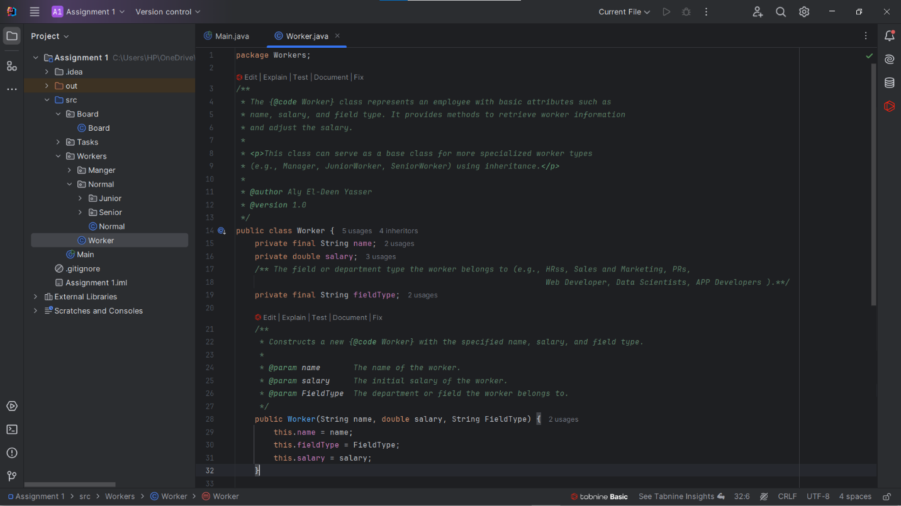

Slide 7
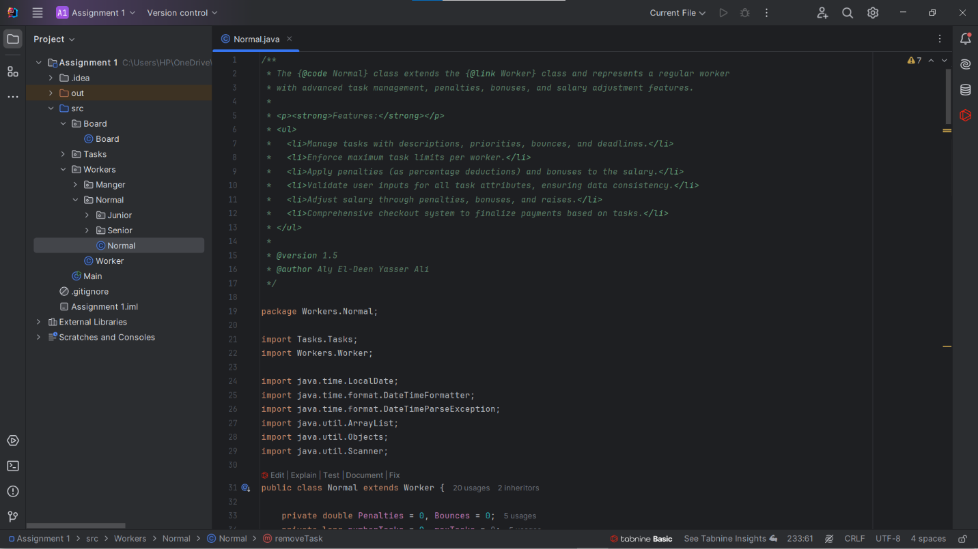

Slide 8
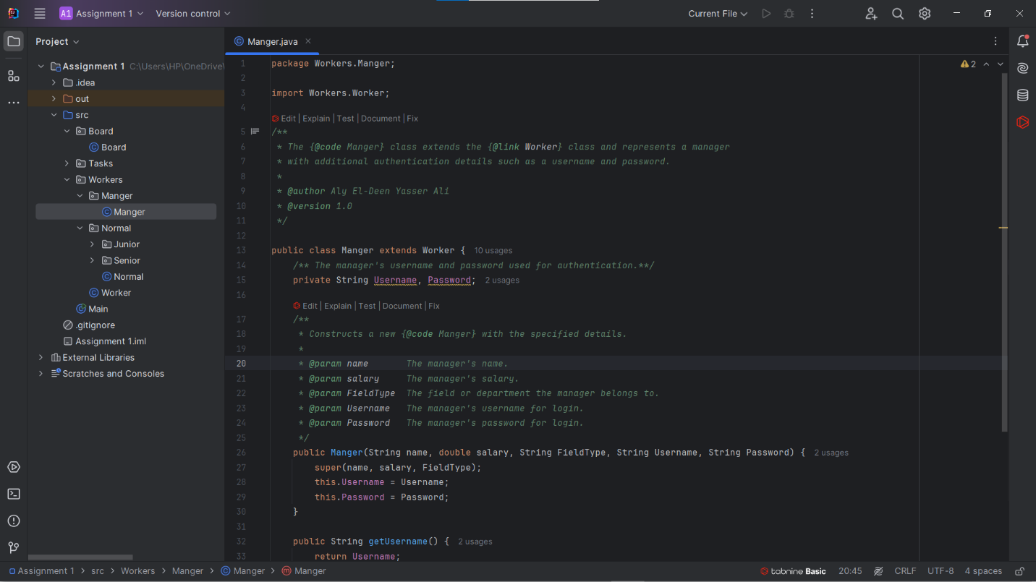

Slide 9
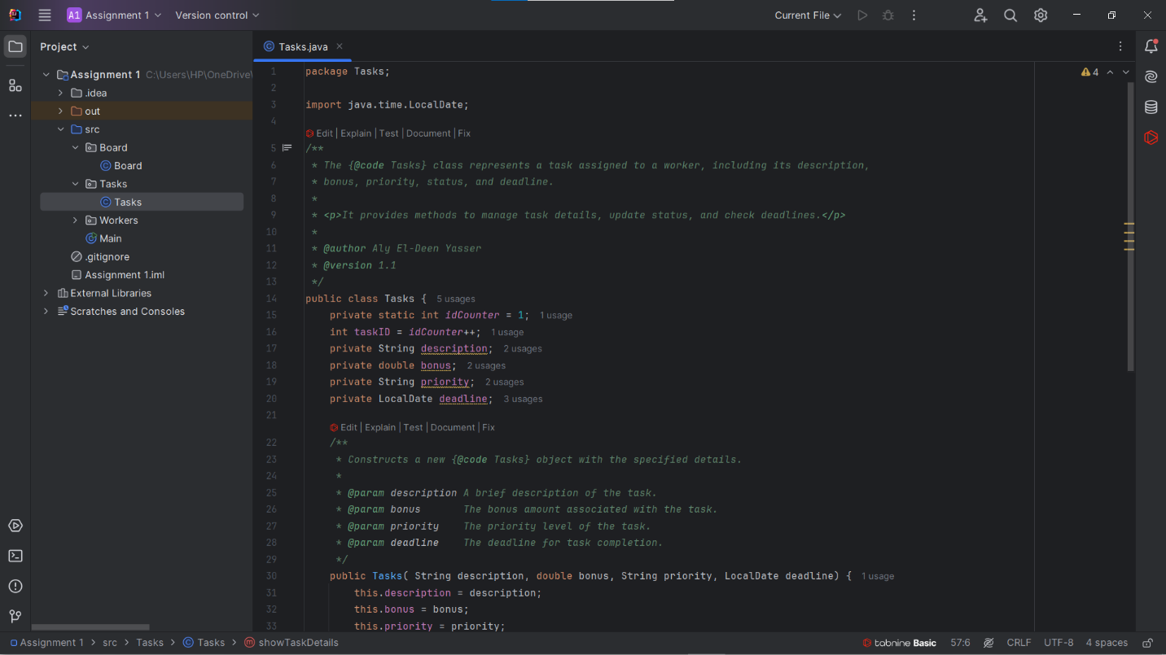

Slide 10
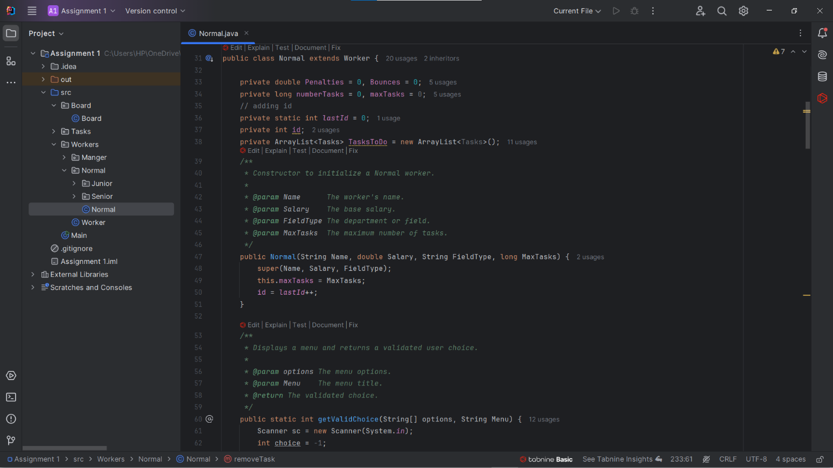

Slide 11
Nagham Wael:
Hours of Study: 12h
Source of Study: Geeks For Geeks + https://youtube.com/playlist?list=PLCInYL3l2AajYlZGzU_LVrHdoouf8W6ZN&si=tfRlF2iNxOtJehum
Video Link: https://youtu.be/VqOBuBvfRiw?si=WCep92XFi12x7LnN

Slide 12
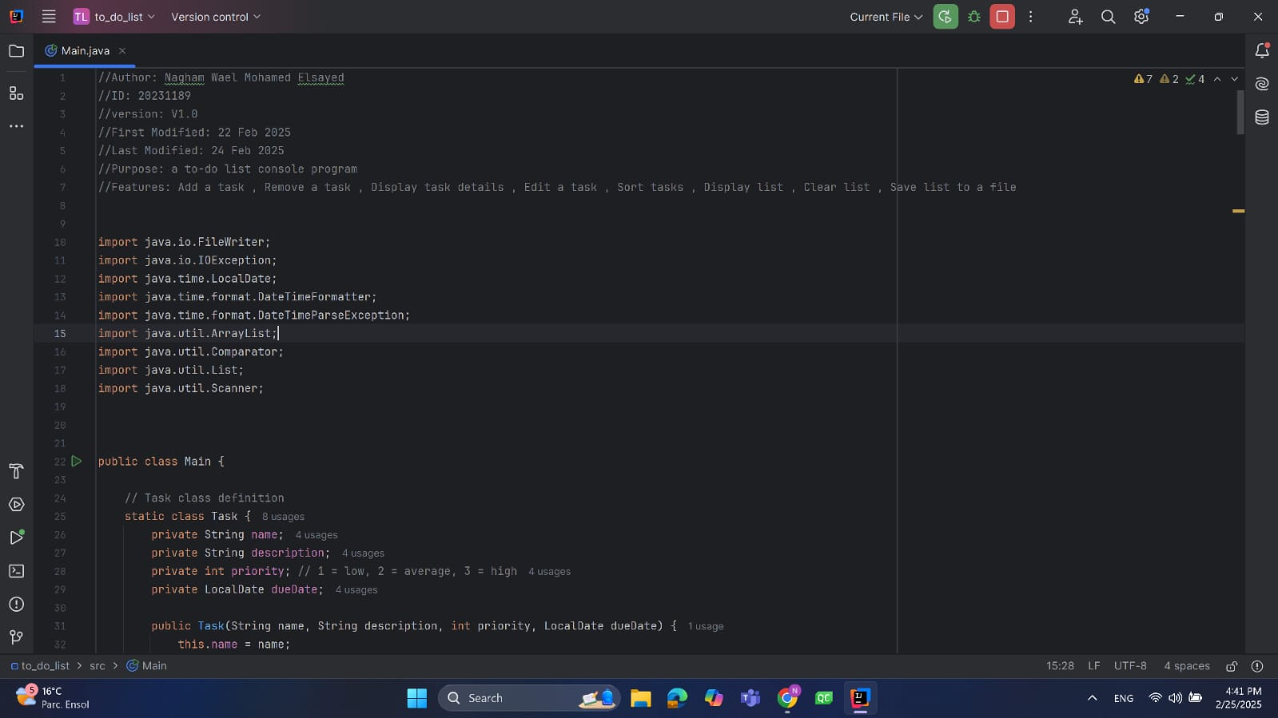

Slide 13
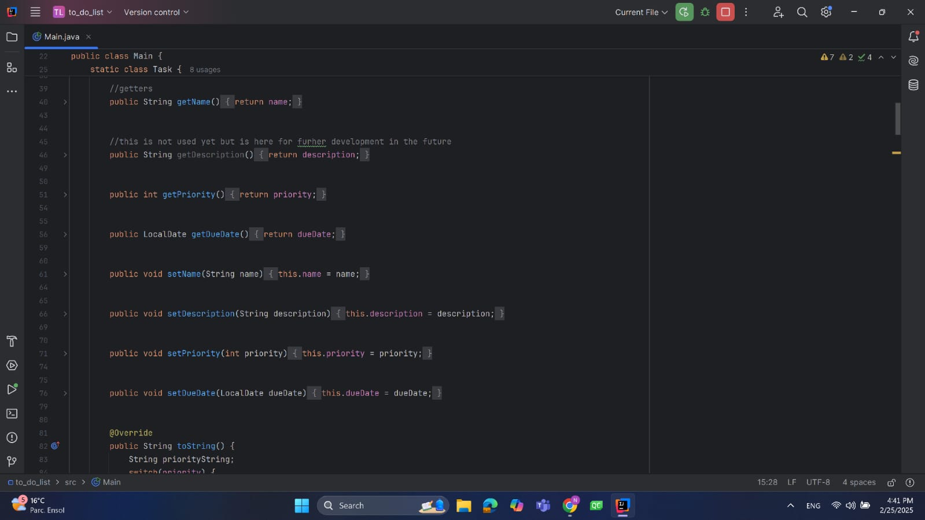

Slide 14
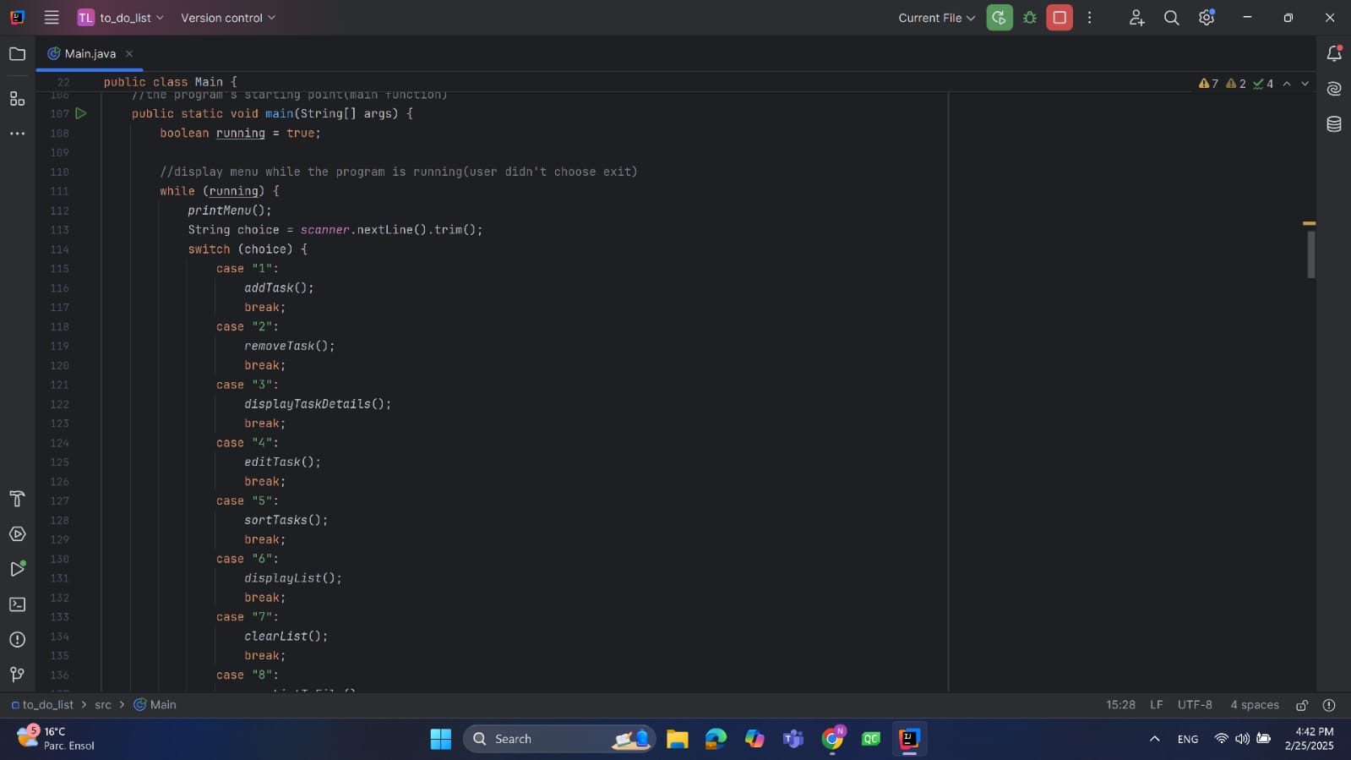

Slide 15
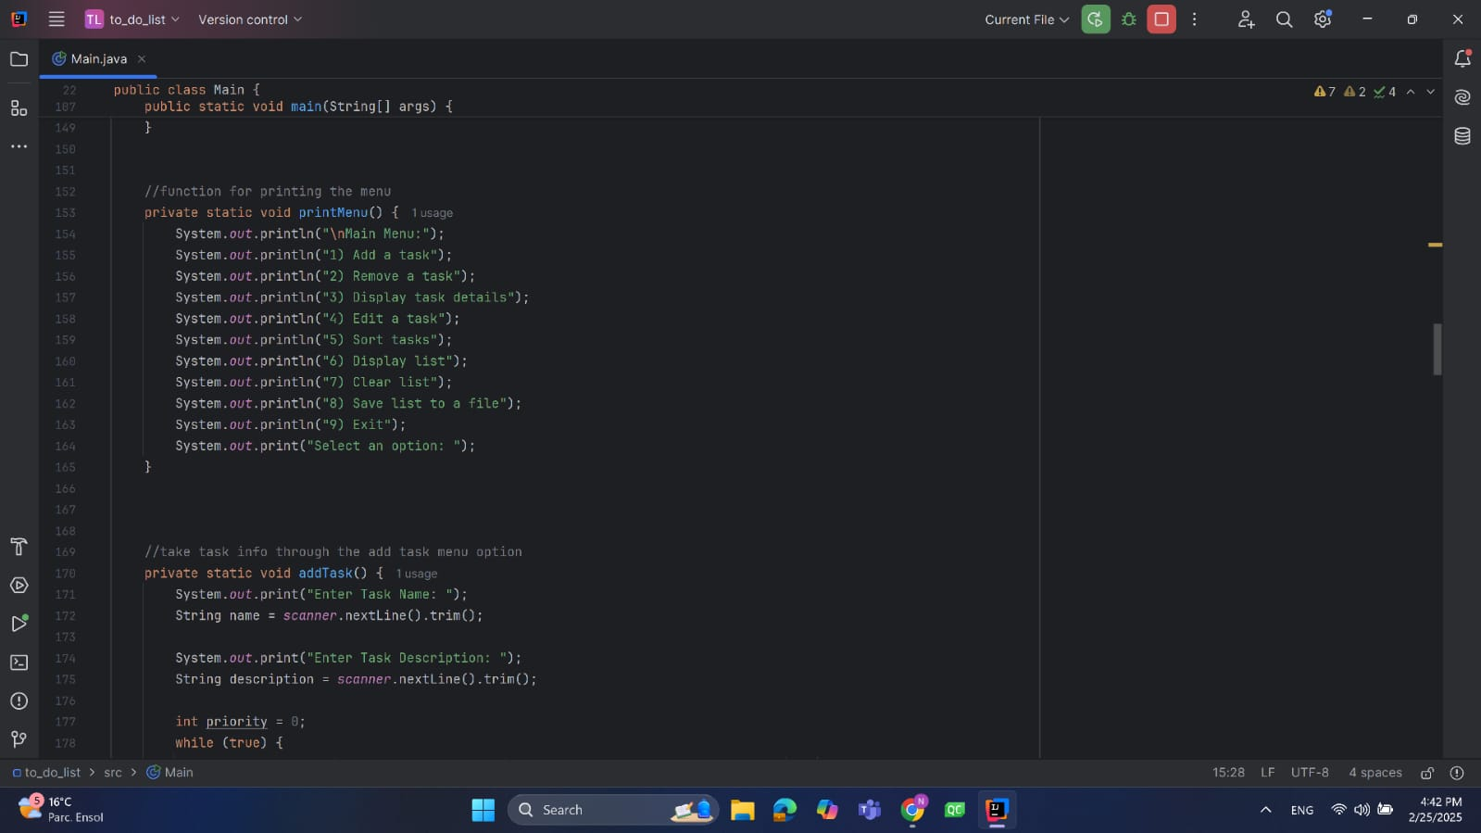

Slide 16
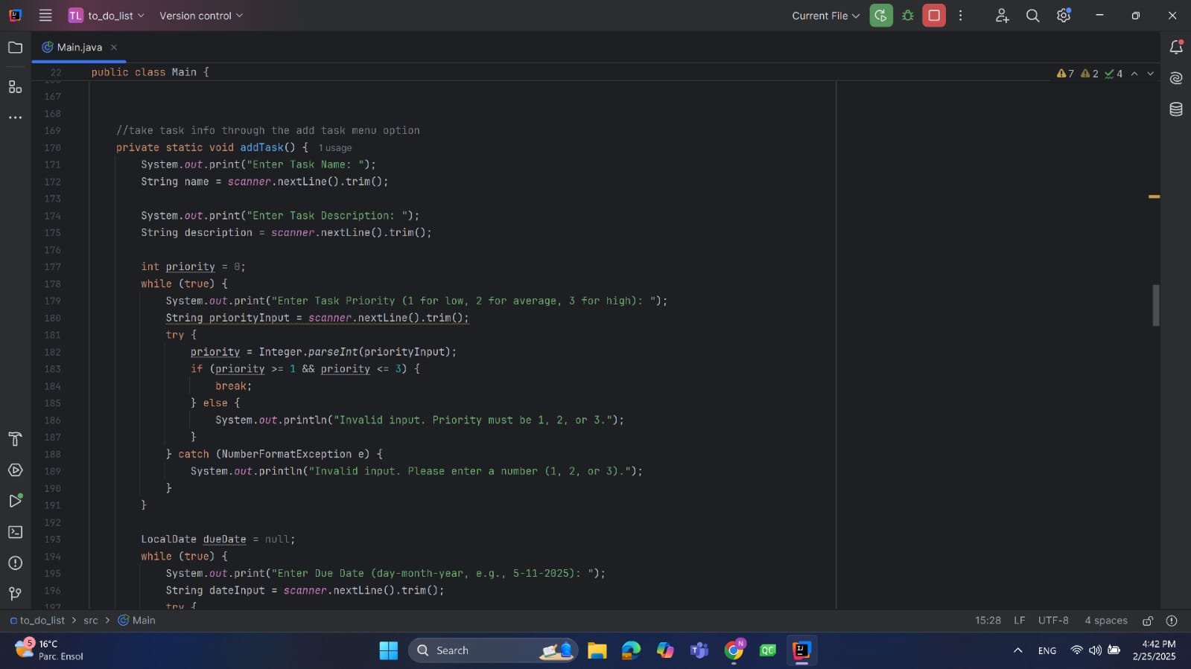

Slide 17
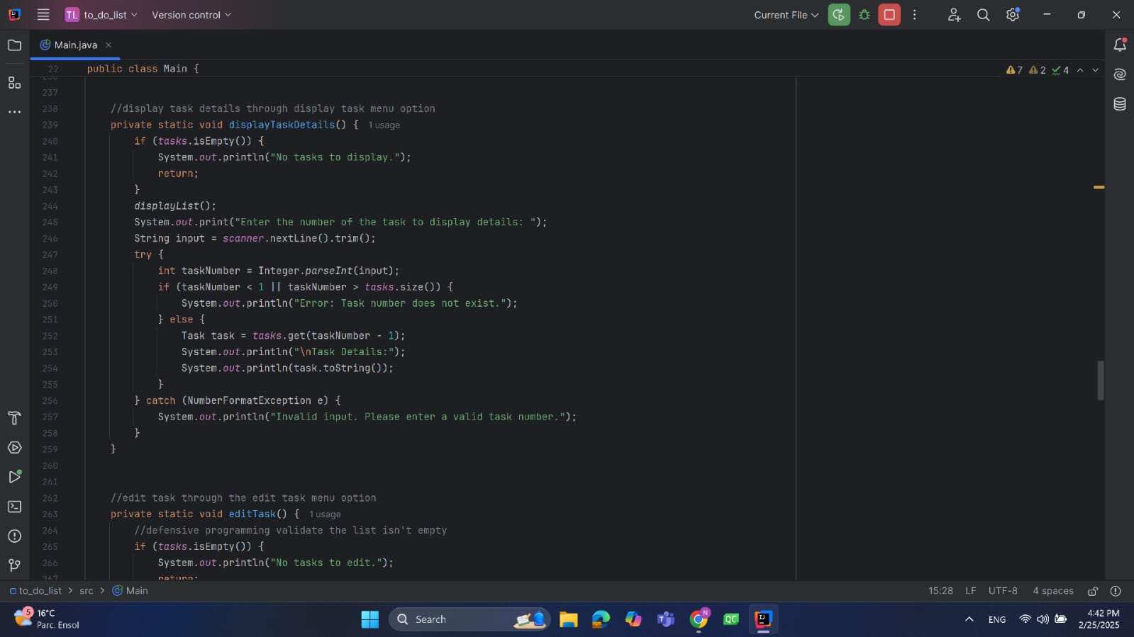

Slide 18
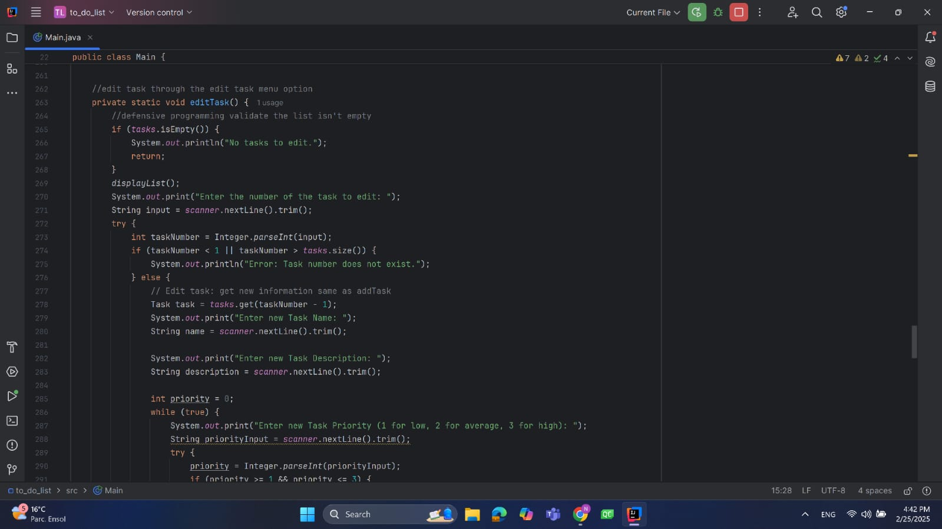

Slide 19
Fatema El-Zhraa Ahmed:
Hours of Study:12 hours
Source of Study : https://www.youtube.com/playlist?list=PLCInYL3l2AajYlZGzU_LVrHdoouf8W6ZN
Video Link: https://www.youtube.com/watch?v=fuV9C_FRDf8

Slide 20
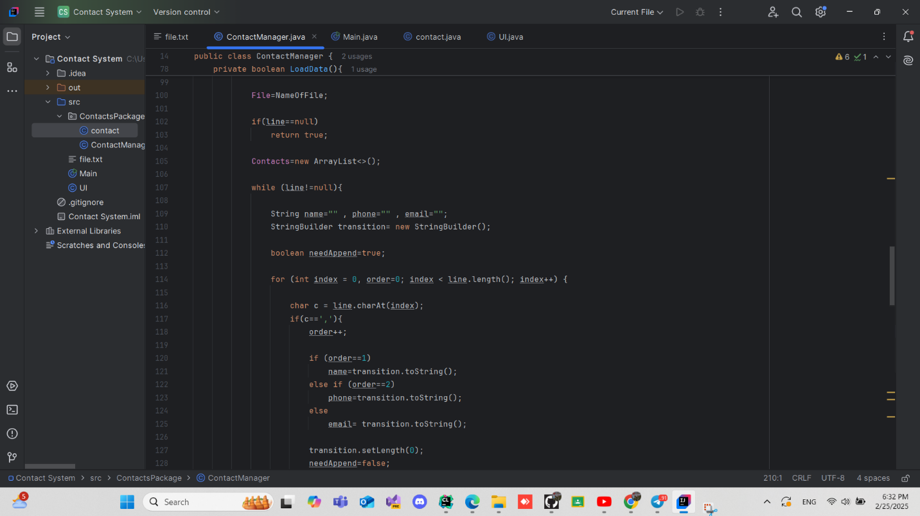

Slide 21
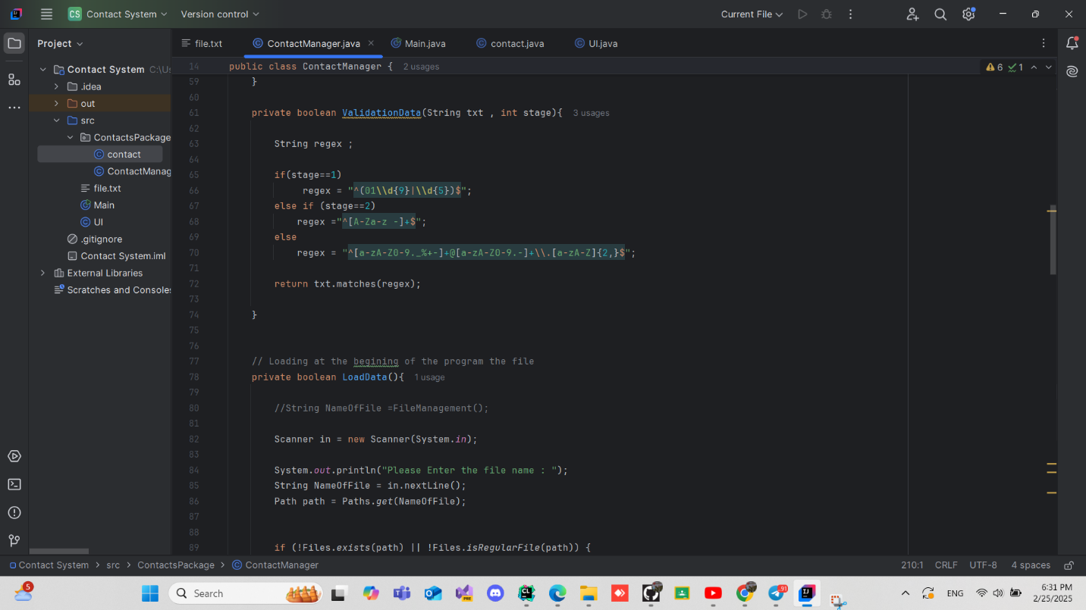

Slide 22
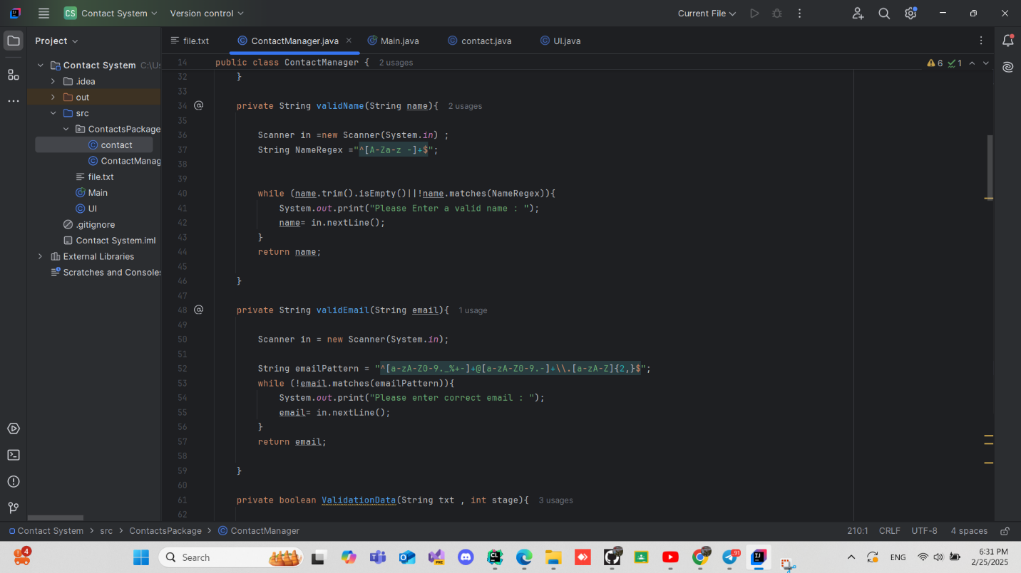

Slide 23
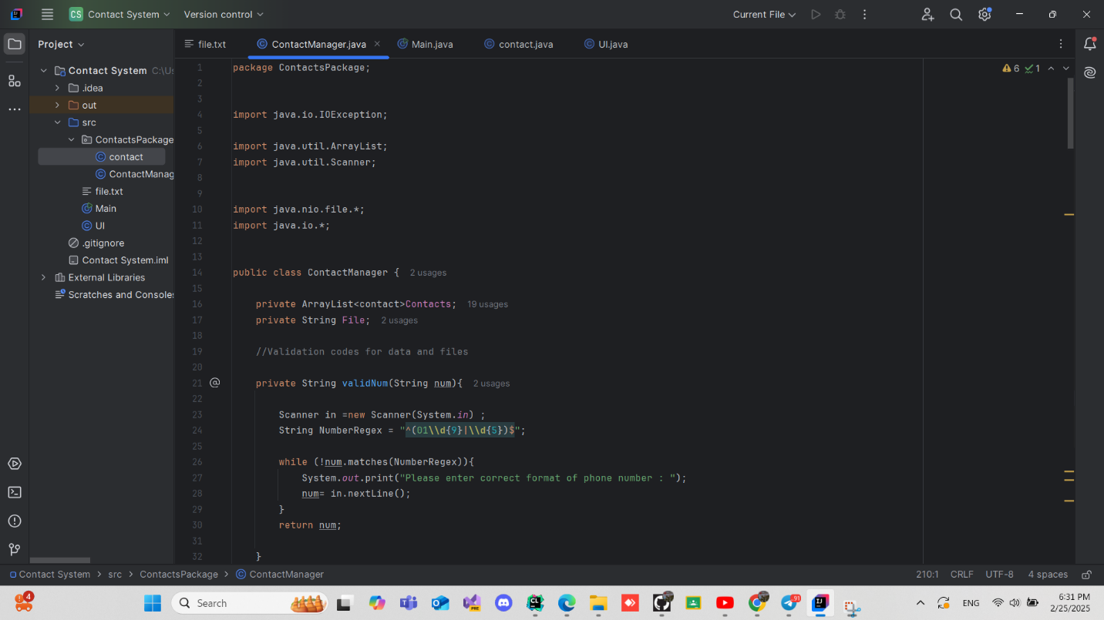

Slide 24
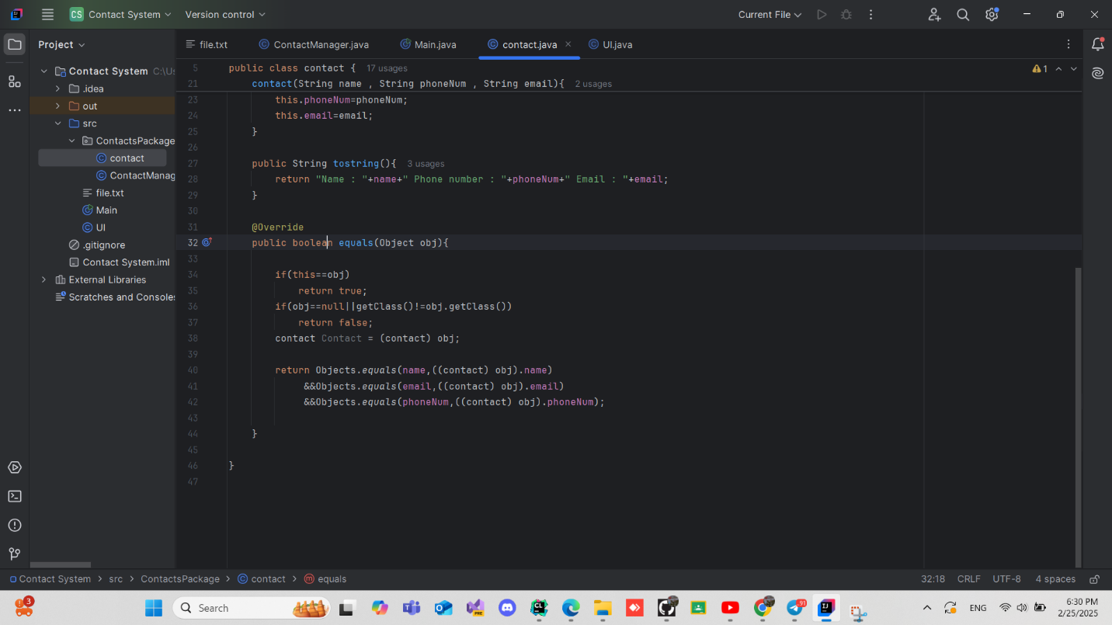

Slide 25
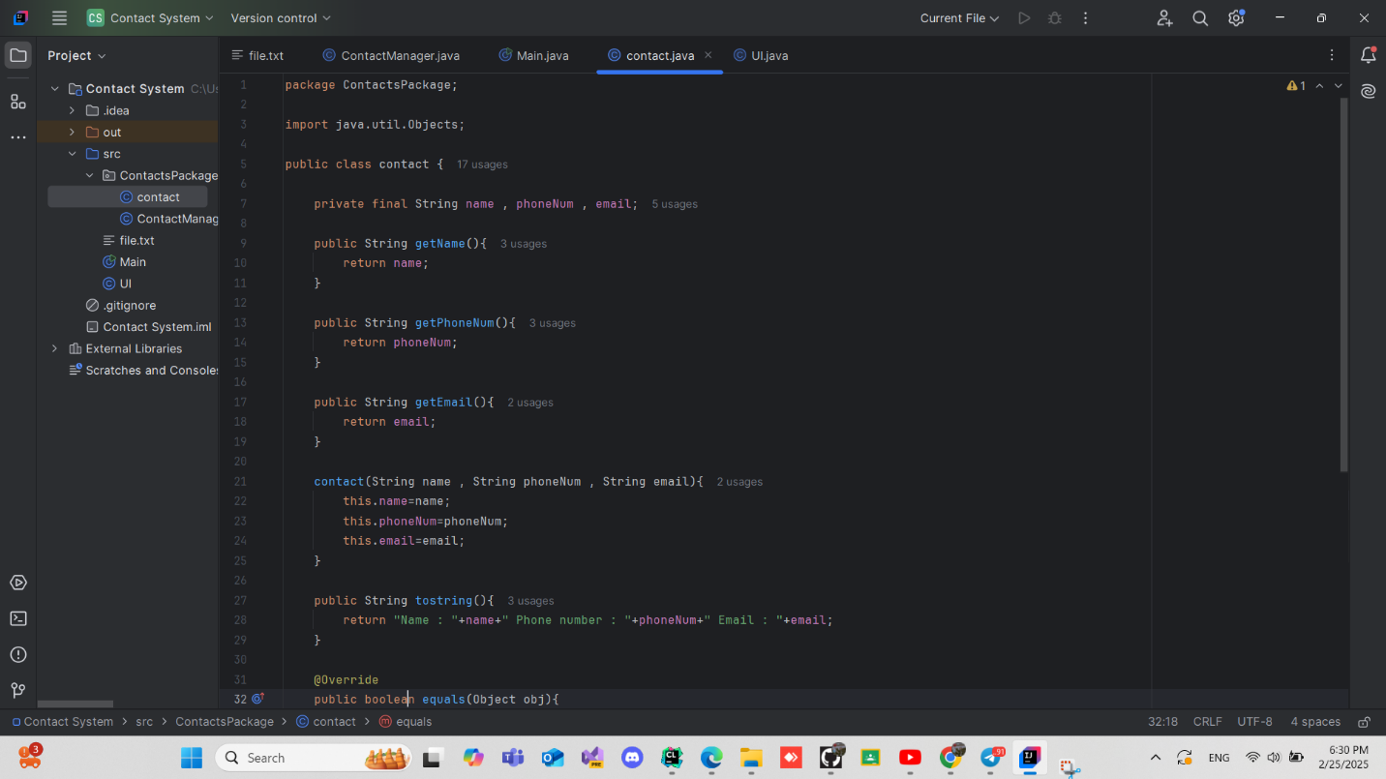

Slide 26
LCNC

Slide 27
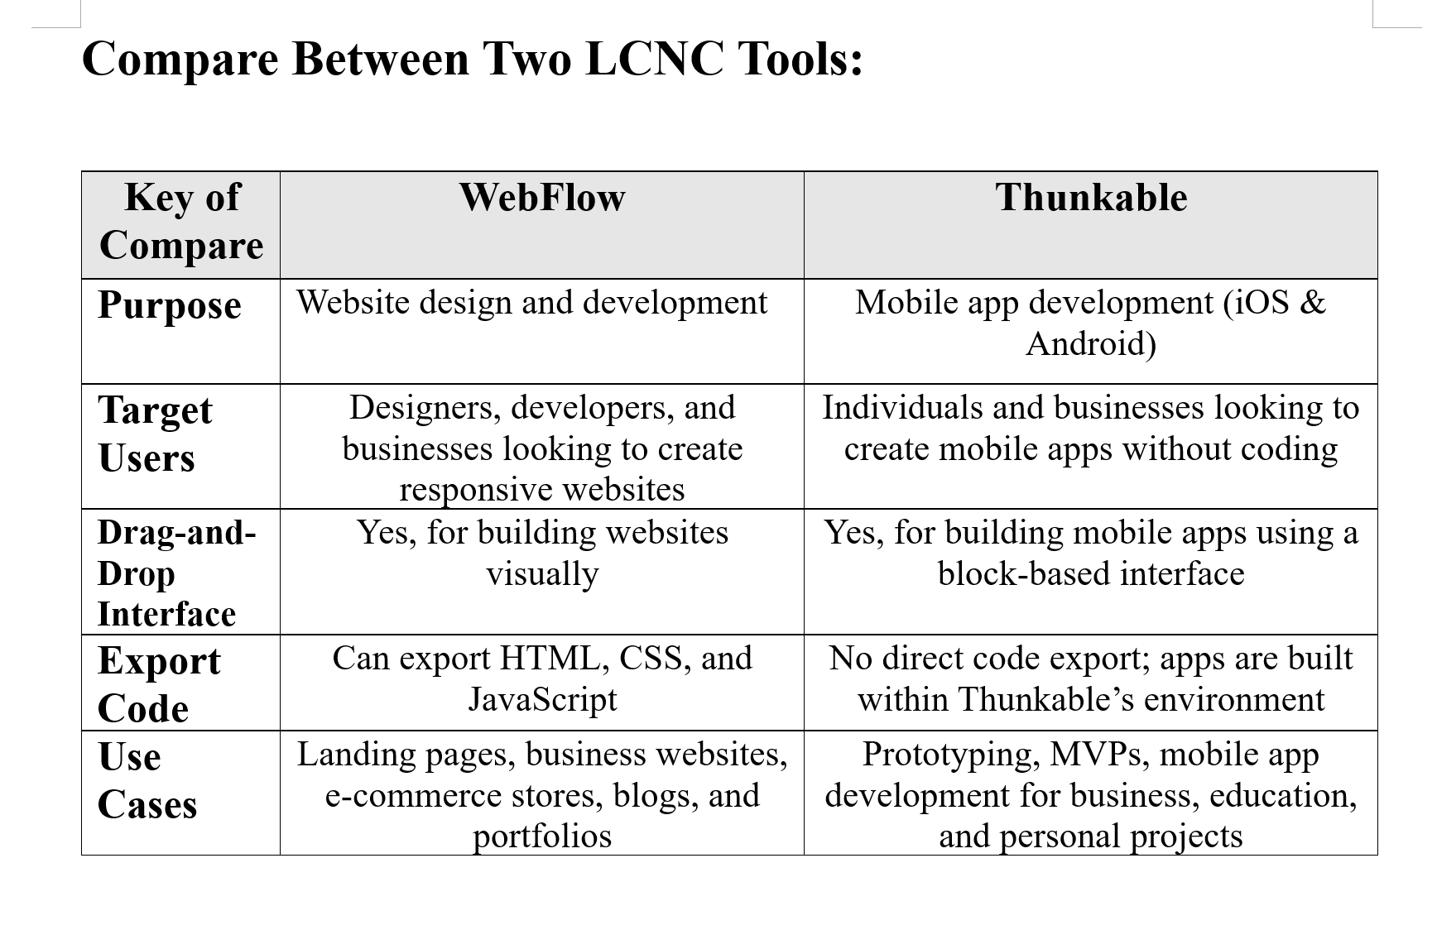

Slide 28
Website link : https://the-house-web.webflow.io/products
Video link: https://youtu.be/c071WQAifNM?si=sWq_lknsMG3GbJbN

Slide 29
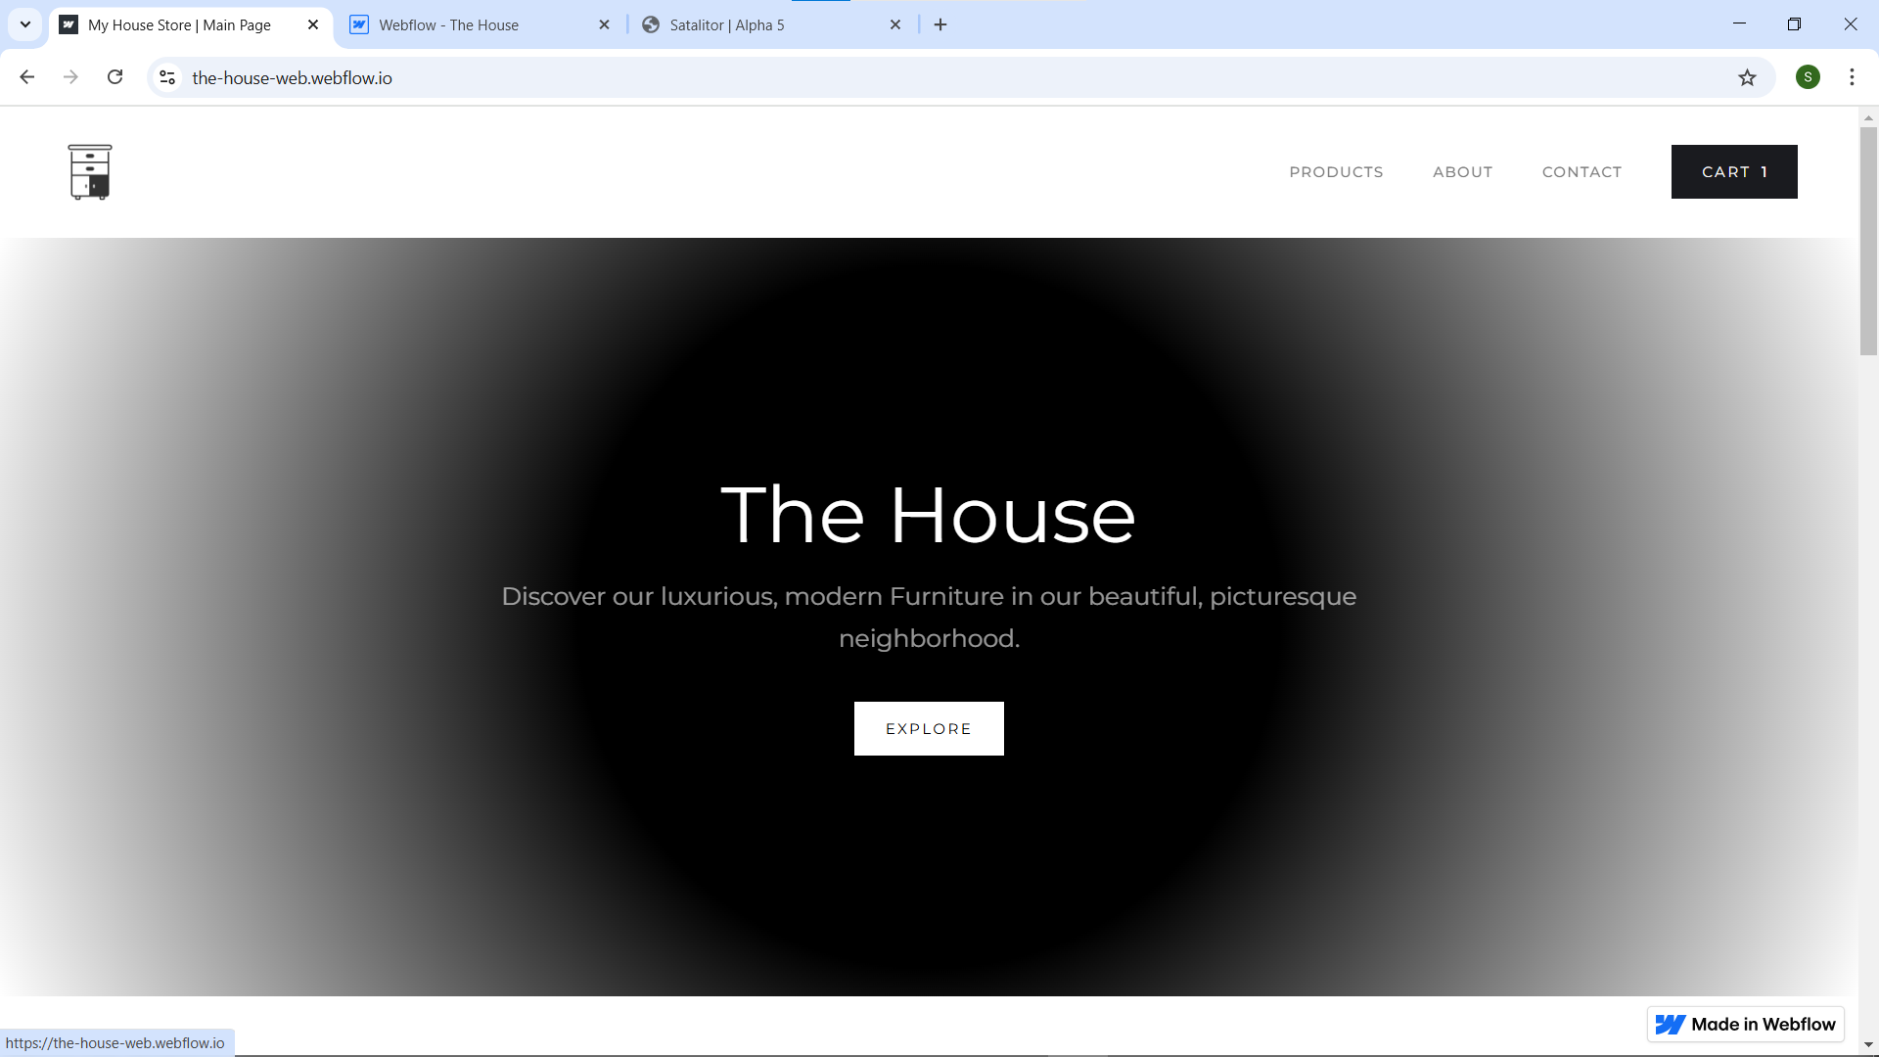

Slide 30
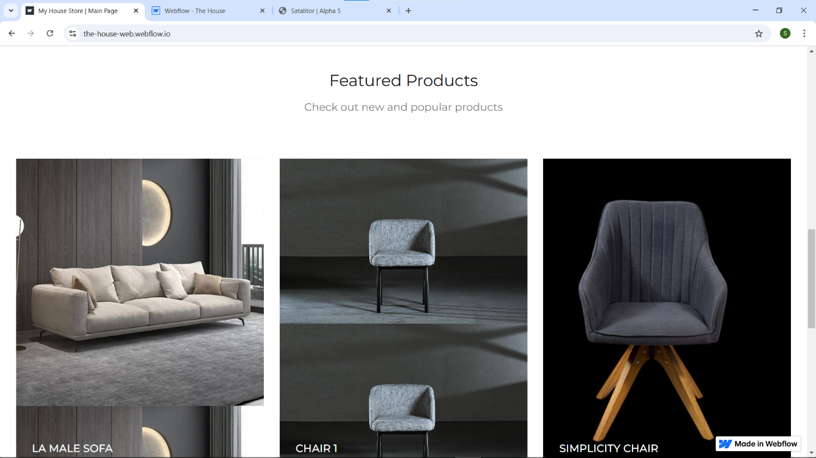

Slide 31
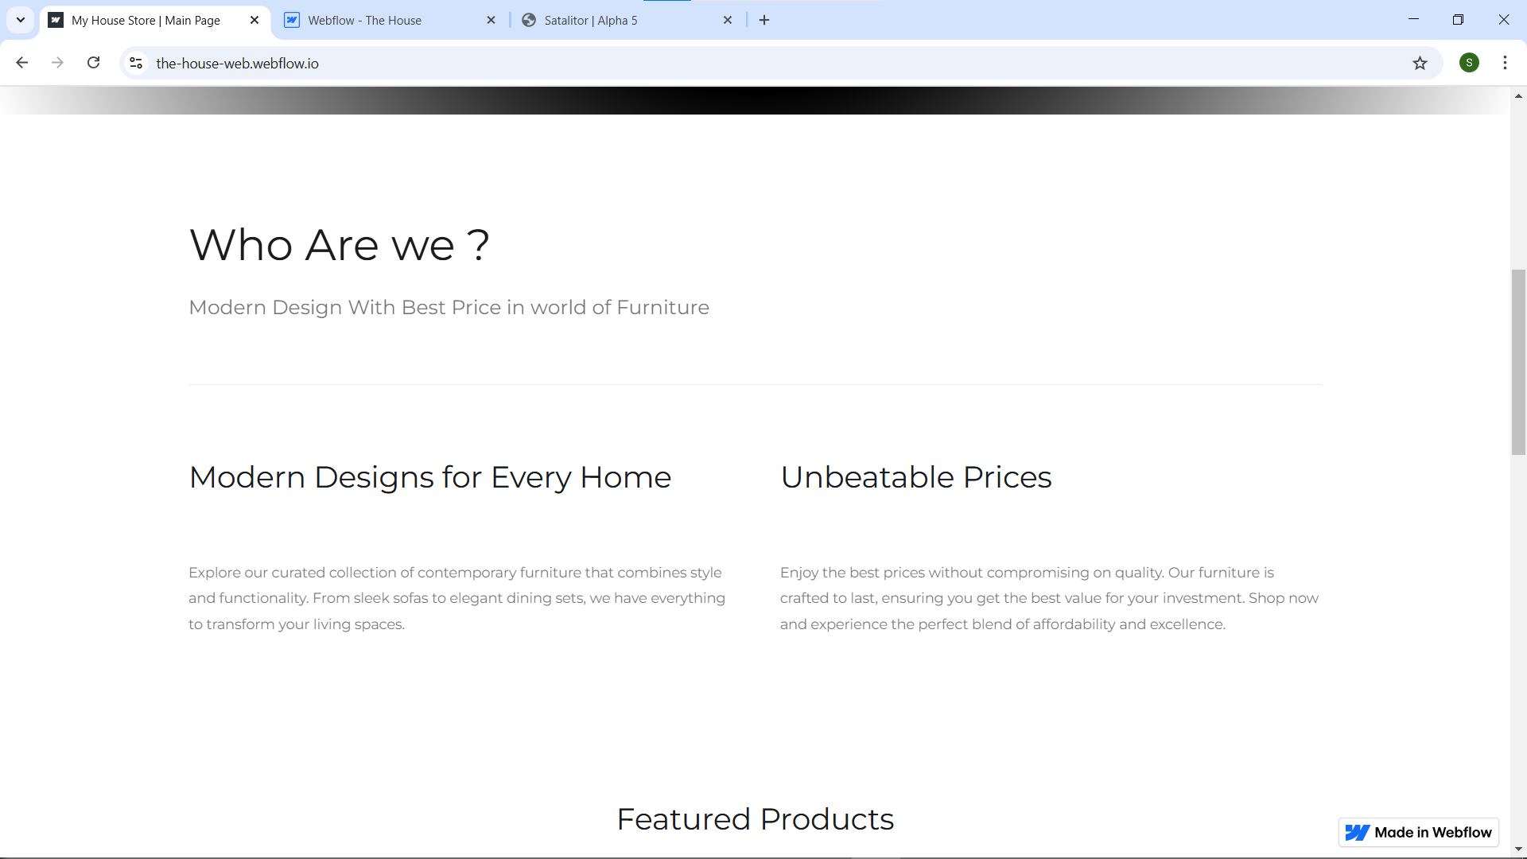

Slide 32
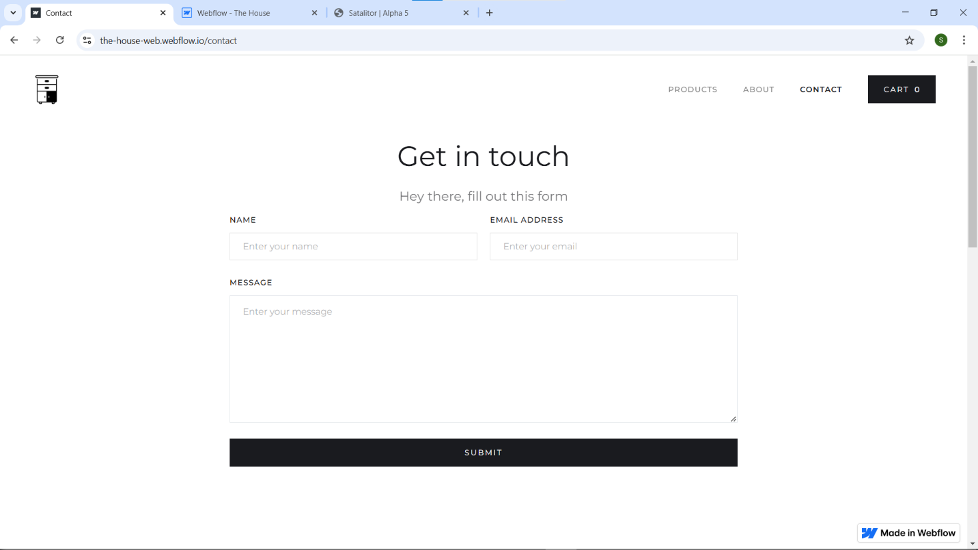

Slide 33
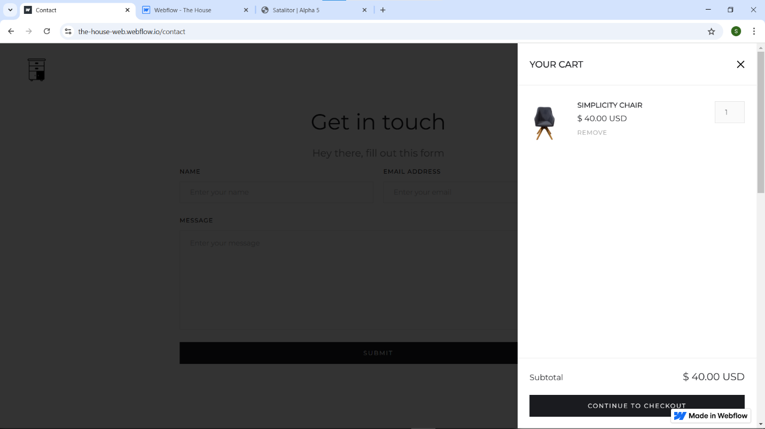

Slide 34
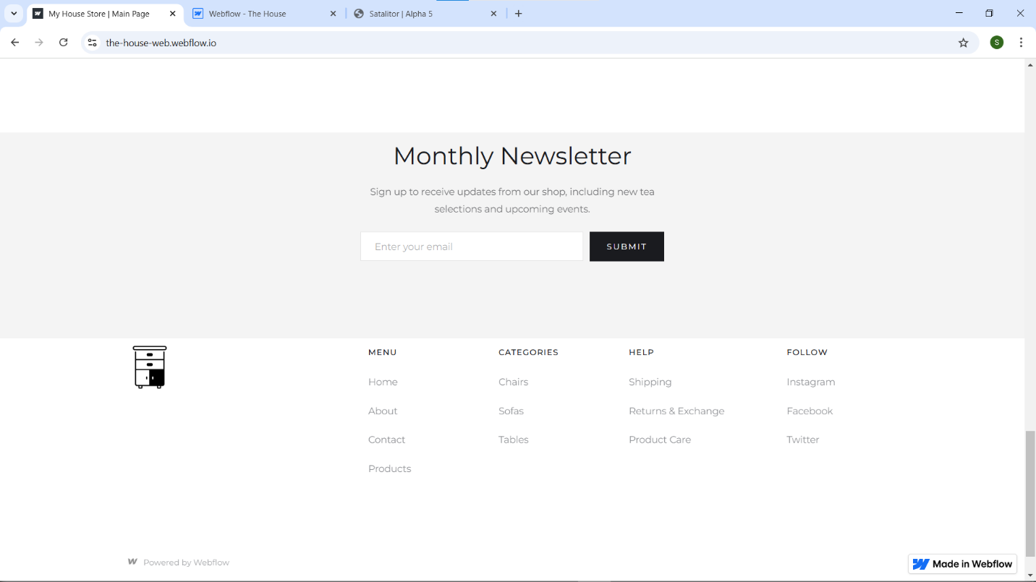

Slide 35
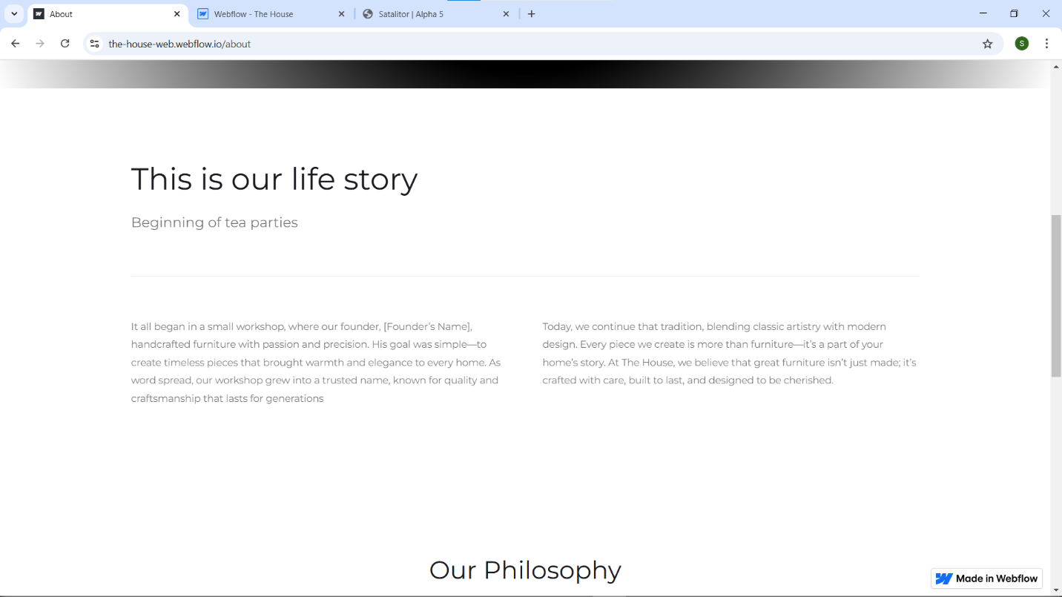

Slide 36
SRS Report Personal Investment Management Software

Slide 37
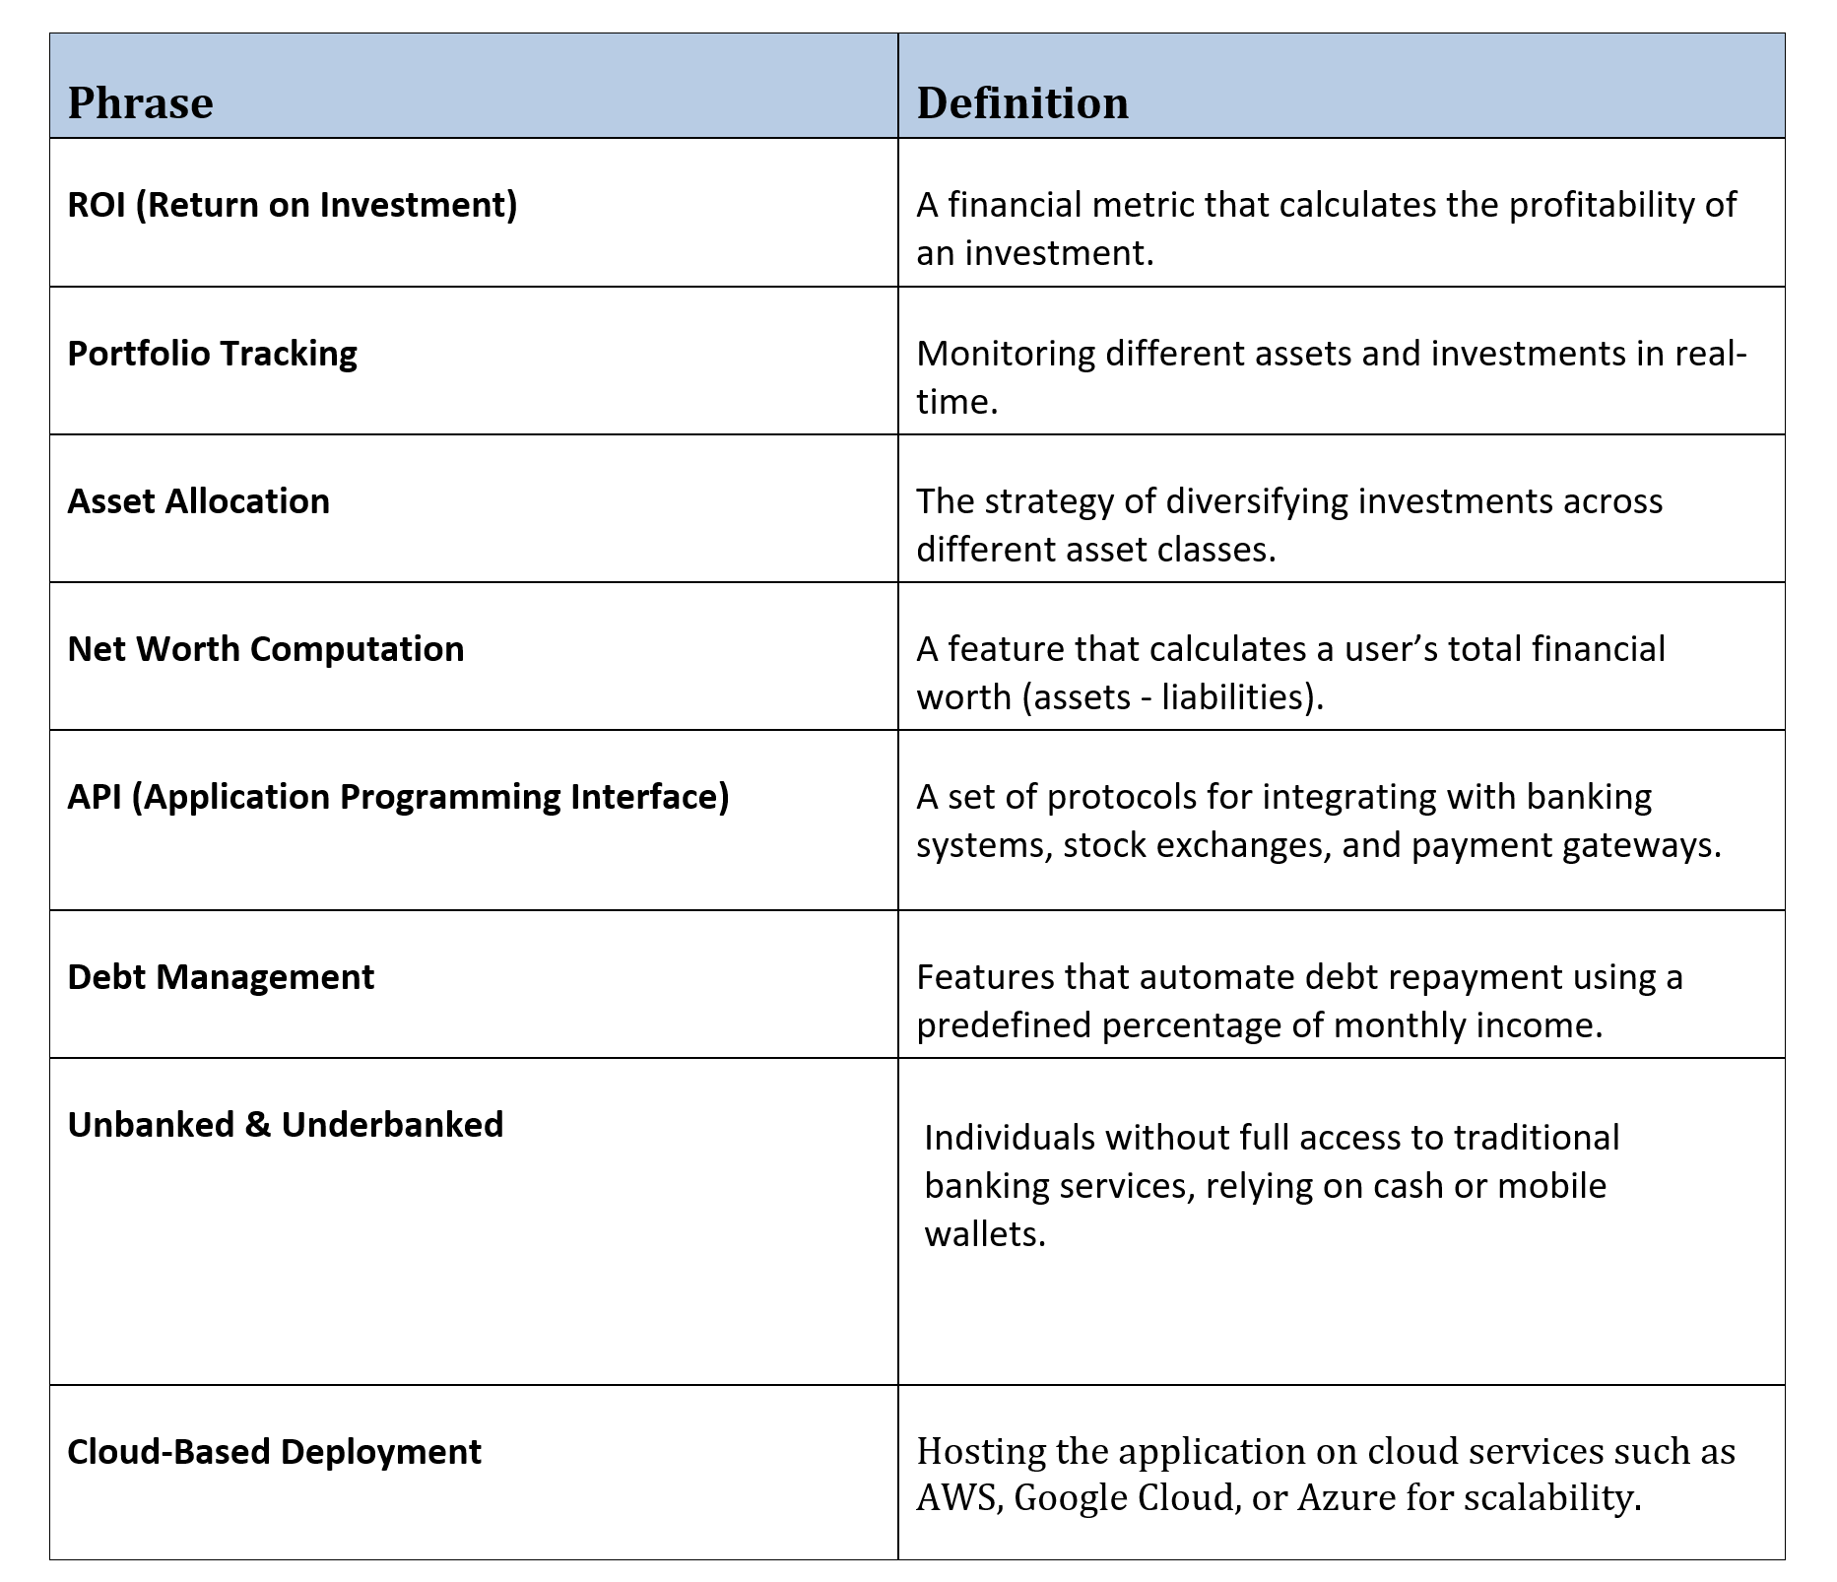

Slide 38
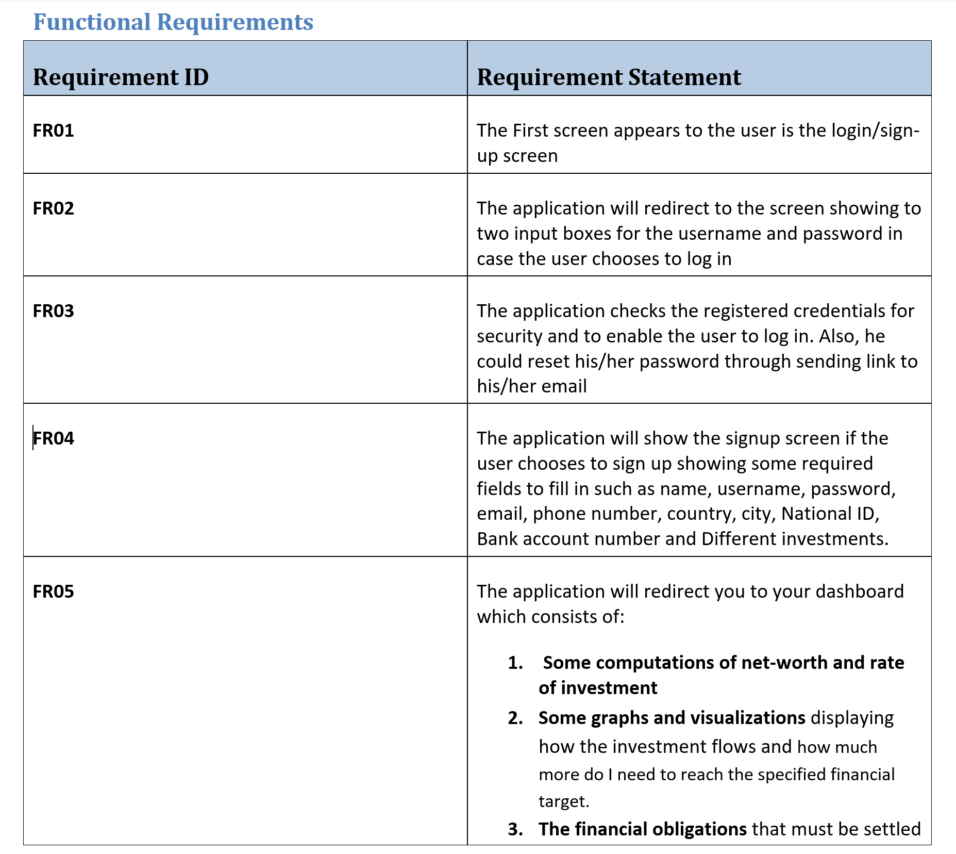

Slide 40
